Slide 1
Kubernetes Native Java for Spring Developer
Kubernetes Native Application Series
Voravit Lertgitipongpant
Senior Solution Architect
Red Hat, Thailand
Chatchai Kongmanee
Specialist Solution Architect
Red Hat, Thailand

Slide 2

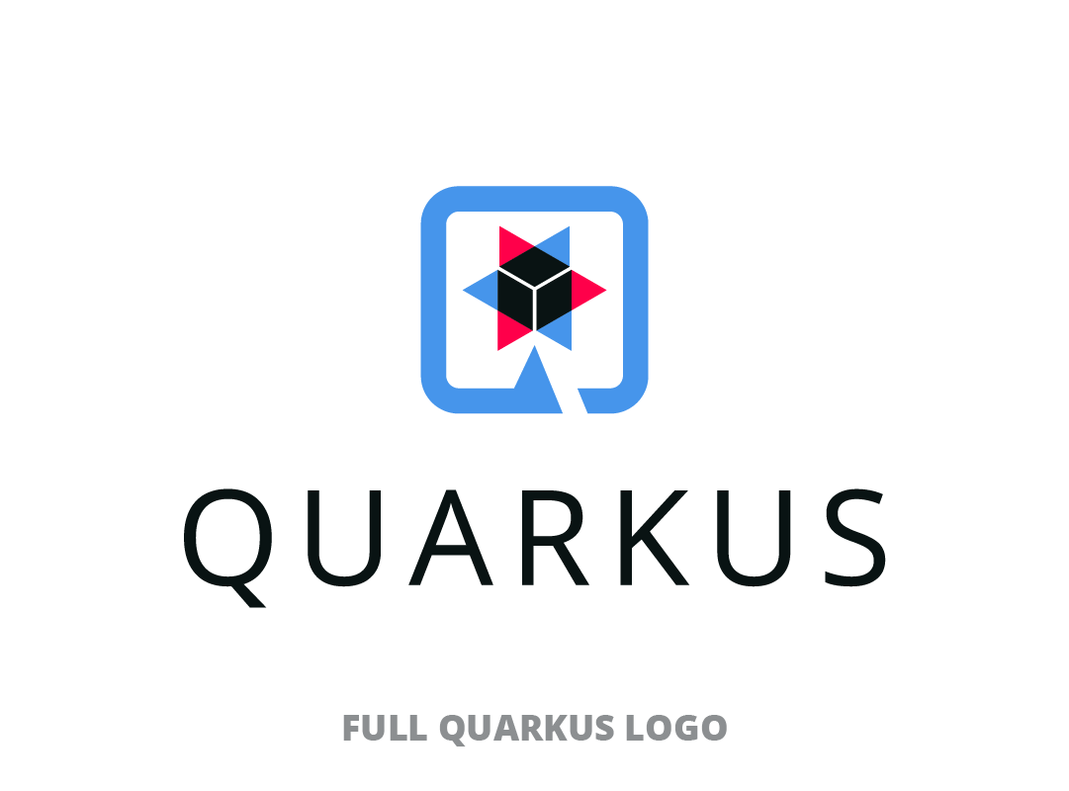



Date & Time
Date & Time
Kubernetes Native Java for Spring Developer
Transform same old spring boot application into Kube-Native Application with amazing fast boot time, small memory footprint and also focus on developer joy with Quarkus
Best Practices for Developing Kube- Native Application
Kubernetes Native Java for Spring Developer
Date & Time
Date & Time
Enhance your microservice on Kubernetes with Event Driven Architecture
Secure Kubernetes Native Application by OpenID with Keycloak

Slide 3
Agenda
Historical Enterprise Java Stack
Why Quarkus?
Demo: First Quarkus!
I’m a Spring developer. Why Quarkus?
Demo: Spring Boot on Quarkus: Magic or madness?

Slide 4
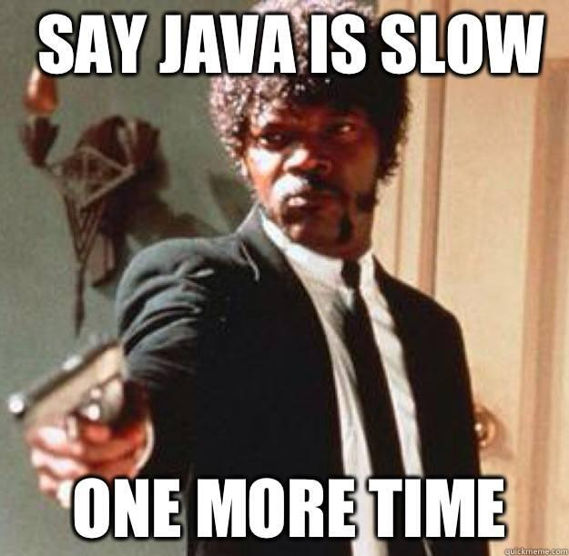
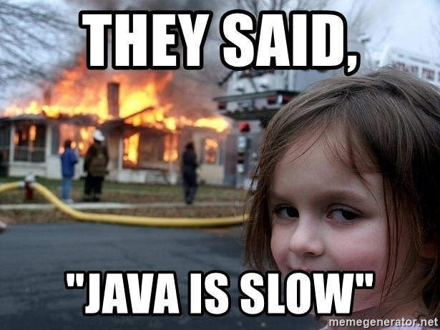

Slide 5
Historical Enterprise Java Stack

Slide 6

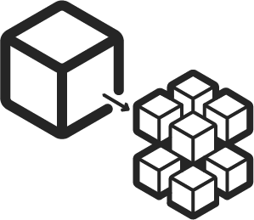










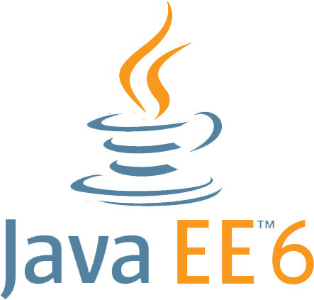



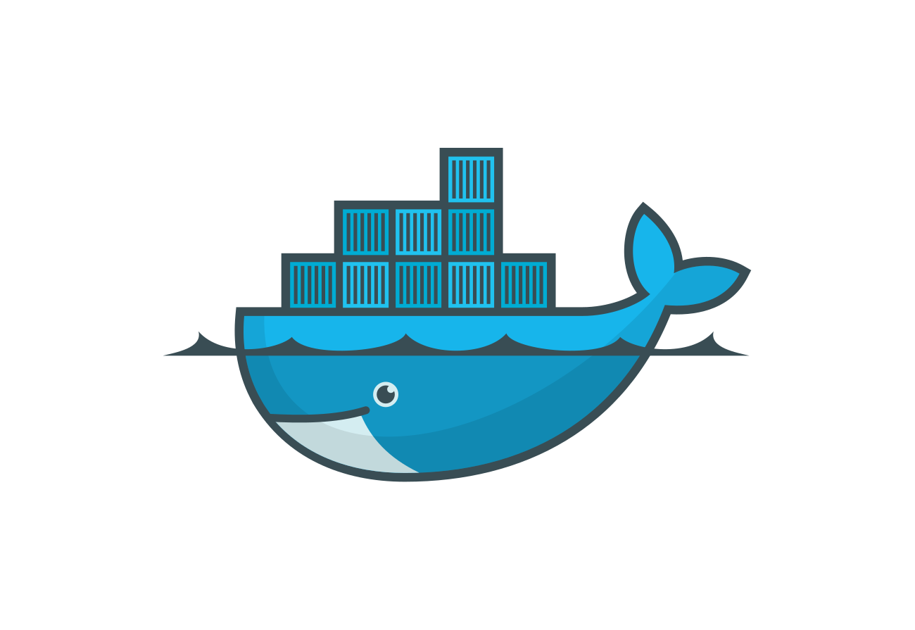
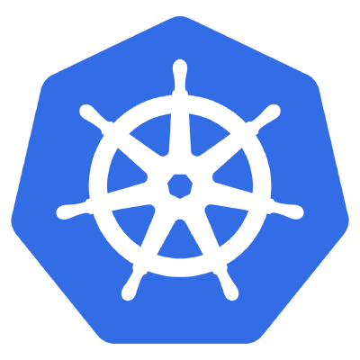



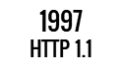








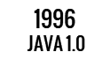






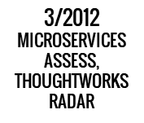



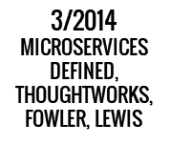



QUARKUS WORKSHOP
2000
RED HAT LINUX
2009
DEVOPS
2007
KVM
Notes:
Historical Java stack consisted of an application server running multiple applications. Red Hat has customers running over 100 applications on one JBoss EAP instance. Over most of the last 15-20 years, the Java application stack has been optimized to run large heaps and highly dynamic frameworks that make decisions at runtime.

Slide 7
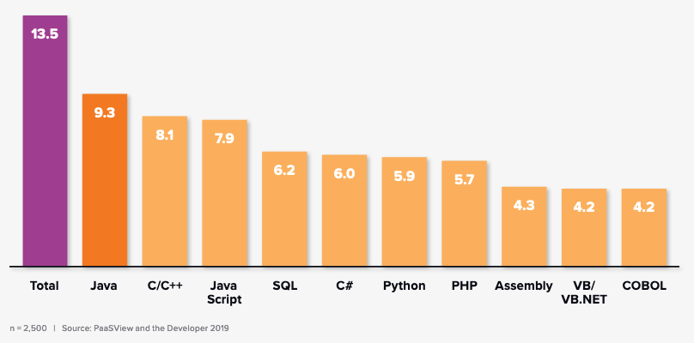
Is Java Still relevant?
Figure 1 below illustrates how more than two thirds of the world’s developers are “heavy to moderate” users of Java.
“As noted by IDC research, Java remains the most popular language used by developers worldwide: 9.3 million of the 13.5 million professional developers worldwide are “heavy to moderate” users of Java in comparison to 8.1 million for C/C++ and 7.9 million for JavaScript in 2020”
n=2,500 | Source: IDC PaasView and the Developer 2019

Slide 8


The Java impedance mismatch
Java design center
Throughput at the expense of footprint
Long running at expense of startup speed
Rich, dynamic behaviour for mutable systems
Cloud-native design center
Throughput solved by scaling
Ephemeral, immutable systems
Footprint and performance matter
Notes:
But it was designed for a different era, and made tradeoffs that are showing their age in the world of cloud-native

Slide 9

Rich dynamic behavior built for mutable systems
Yet containers are primarily immutable
Notes:
[click]
In the early days of Java we saw development of frameworks which matched the design goals and target deployment platforms of Java.
These frameworks did a lot of acrobatics to keep the apps flying in the air, and even allowed developers to modify the app it as it flew.
[click]
With the rise of cloud computing and containers, this dynamic behavior and associated heavy footprint of Java apps no longer matches how developers and operations teams want to build and deploy applications today.

Slide 10
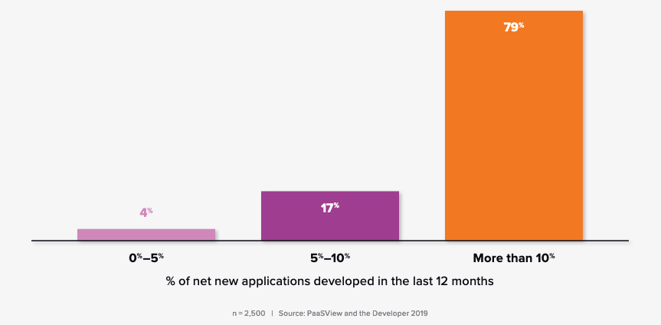
How important is containers for developers?
Figure 2: Percent of developers who use containers for net new apps.
“The popularity of Java and the emerging use of containers suggest the need to optimize the deployment of Java in container-native and Kubernetes-native environments”
IDC - Red Hat Quarkus Lab Validation
n=2,500 | Source: IDC PaasView and the Developer 2019

Slide 11
Java and containers: The hidden truth
State of Java in the Cloud
Compute node
Compute node
Compute node
HotSpot
NodeJS
Go
Go
Heap
NodeJS
Go
Go
HotSpot
Heap
NodeJS
Go
Go
NodeJS
Go
Go
HotSpot
Heap
NodeJS
Go
Go
NodeJS
Go
Go
HotSpot
Heap
NodeJS
Go
Go
Container platform

Slide 12
Languages used on AWS Lambda
State of Java in the Cloud
“Before we introduced Quarkus, many customers had started to look at alternative stacks like Go and node.js to improve performance and efficiency. These customers were weary of selecting a new language and having to hire new developers or retrain their existing Java developers.”
-- Arijit Mazumdar, WiPro Digital https://quarkus.io/blog/tag/user-story/
51%
Node.js
38%
Python
6%
Java

Slide 13

Supersonic. Subatomic. Java.
Notes:
Historical Java stack consisted of an application server running multiple applications. Red Hat has customers running over 100 applications on one JBoss EAP instance. Over most of the last 15-20 years, the Java application stack has been optimized to run large heaps and highly dynamic frameworks that make decisions at runtime.

Slide 14
DEMO Time!

Slide 15
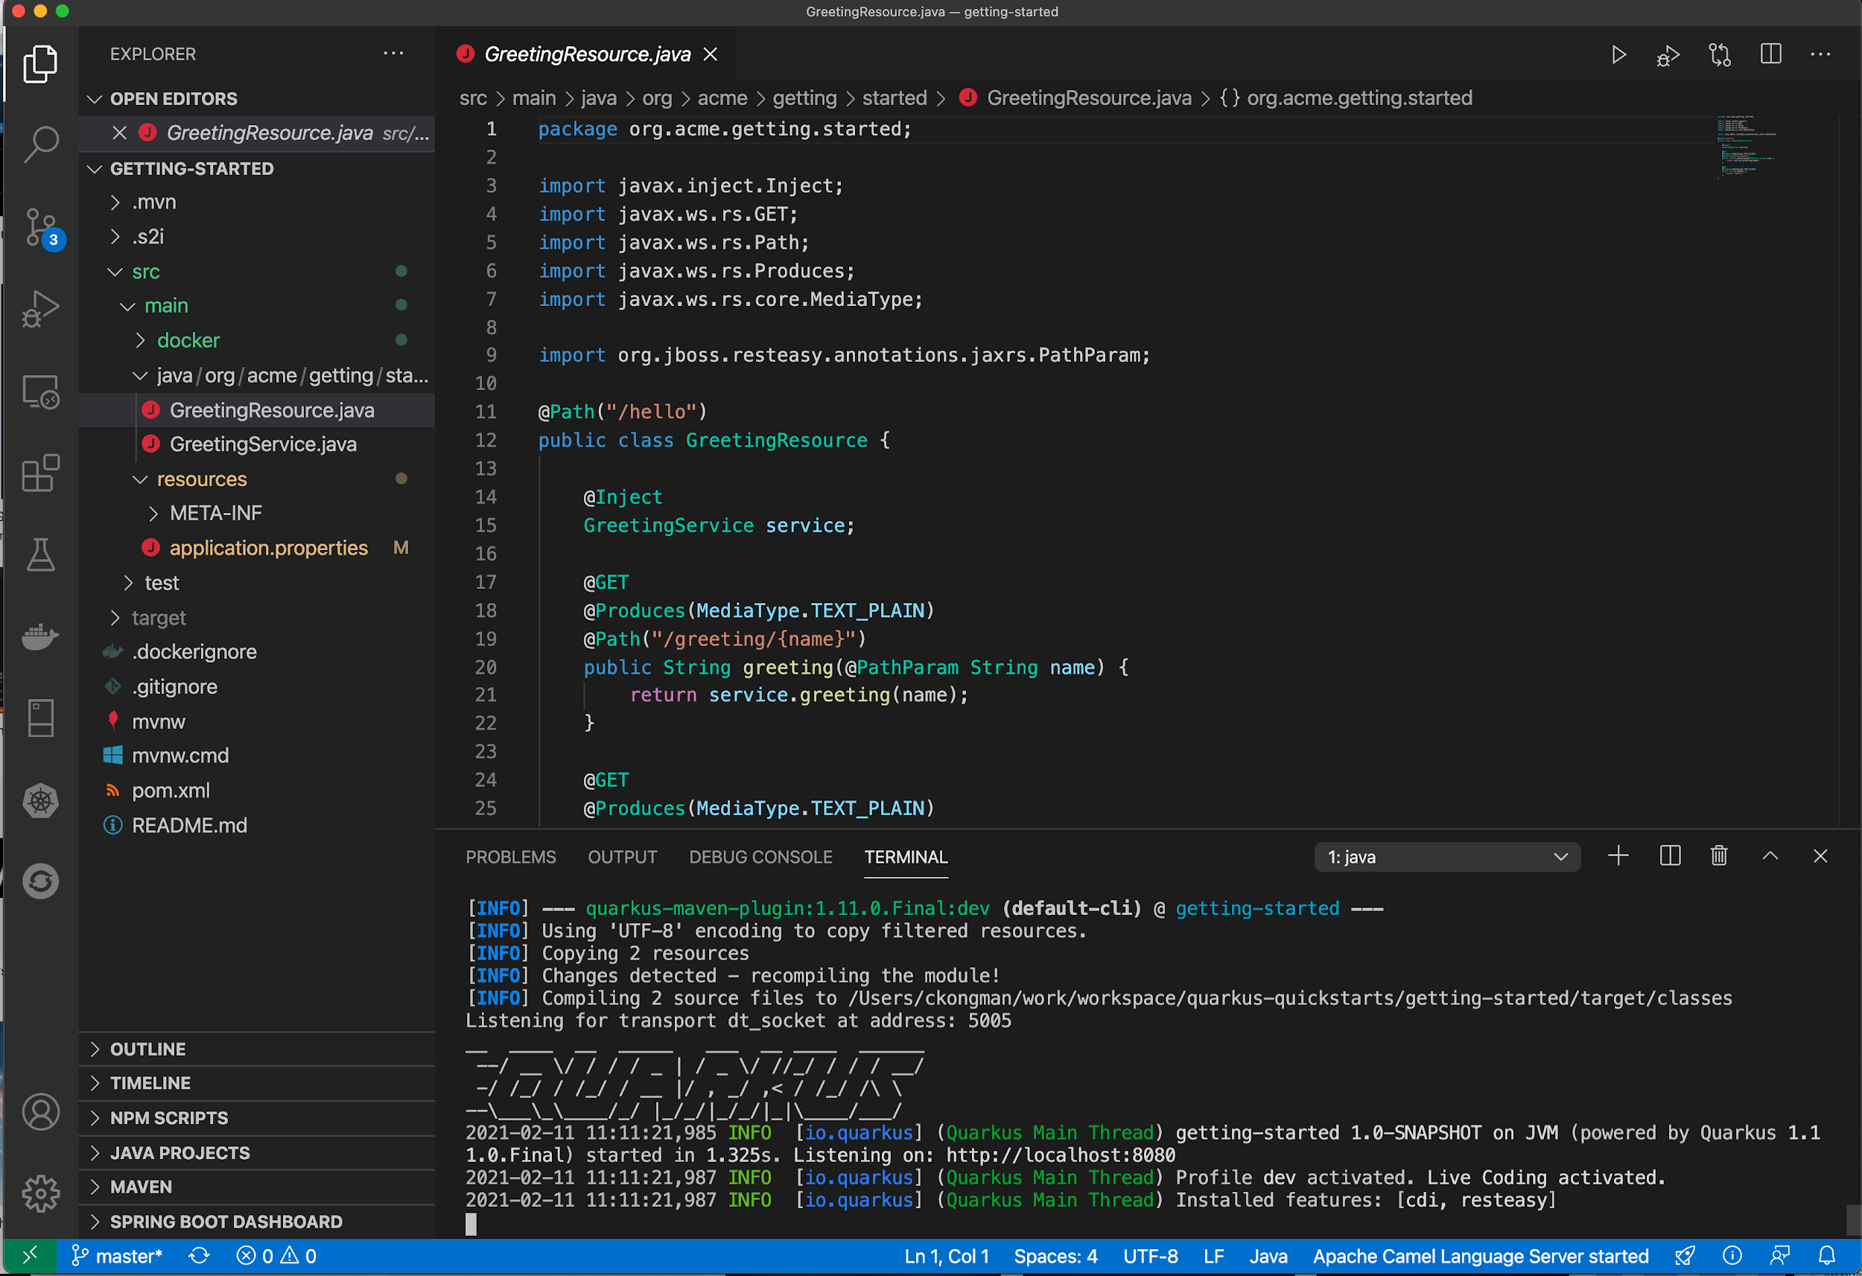
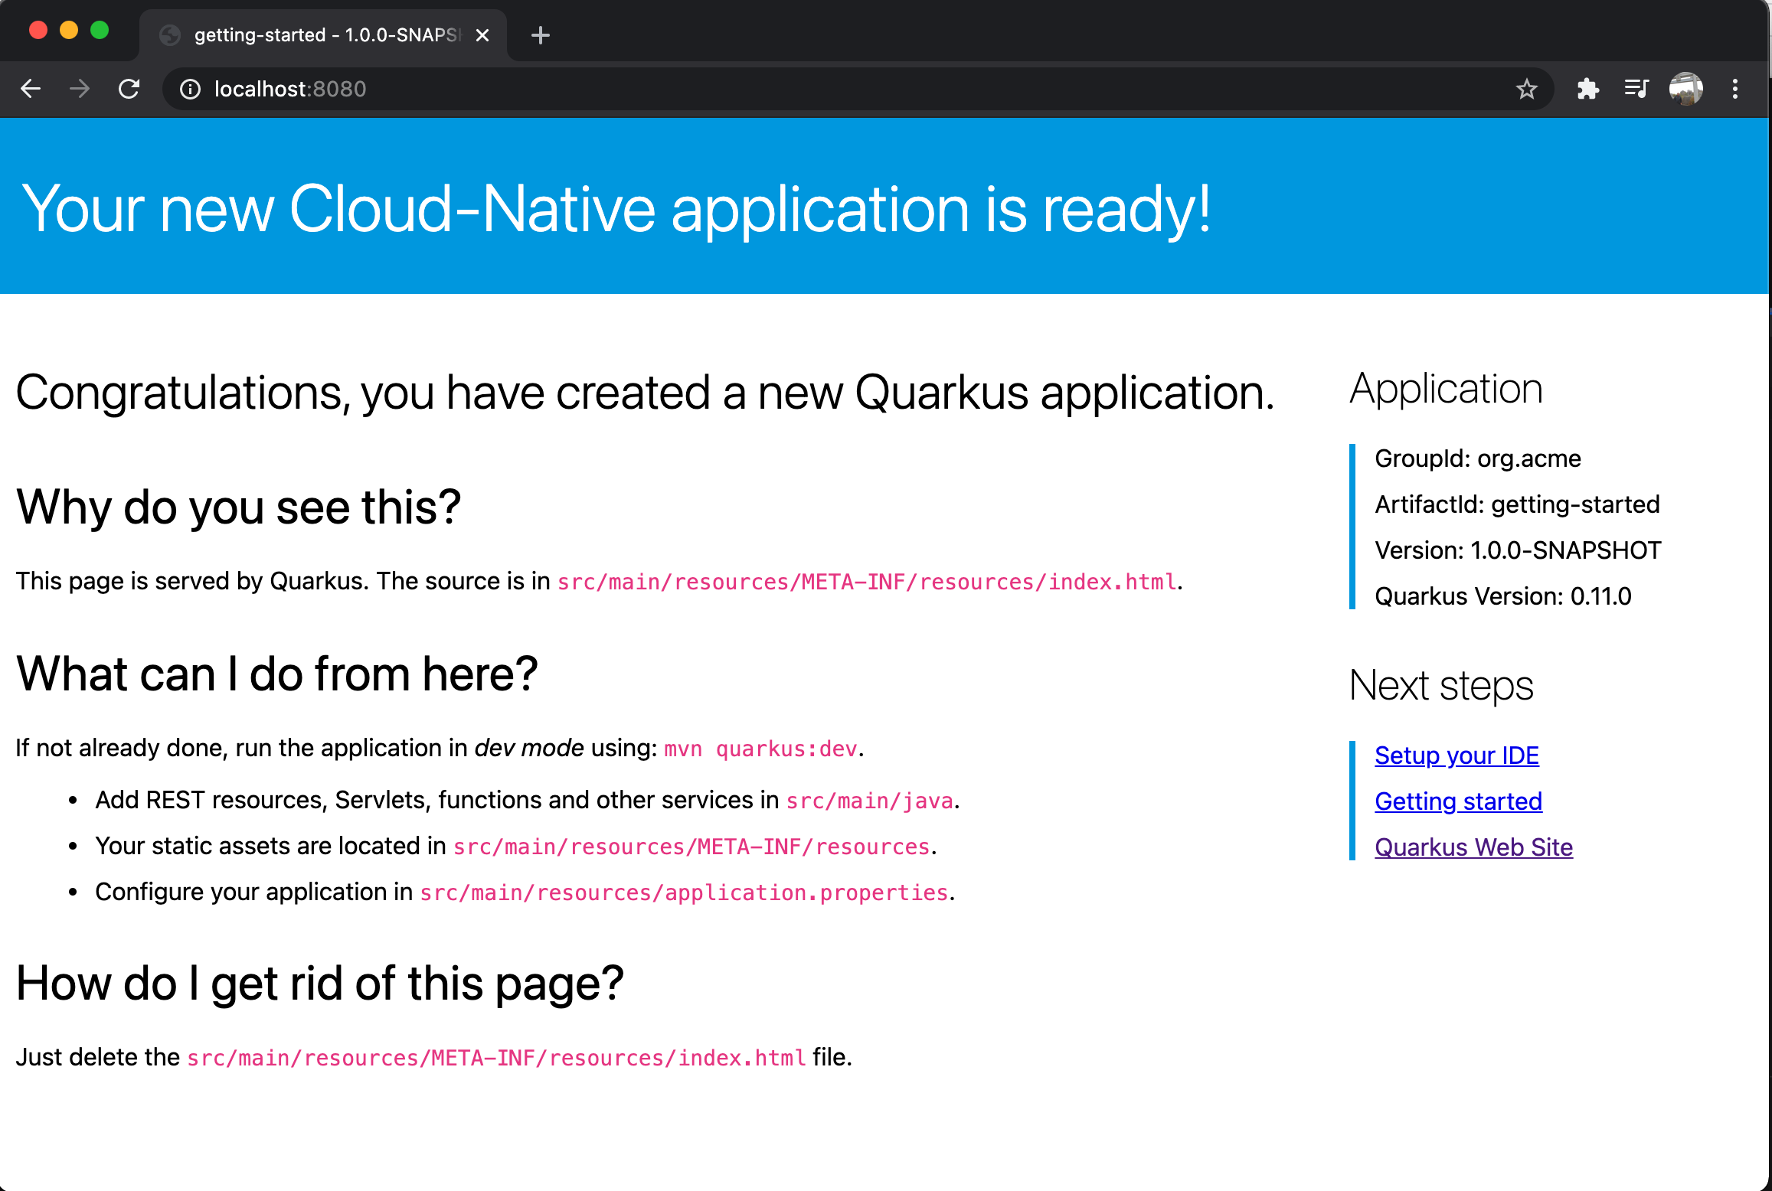
First Quarkus

Slide 16
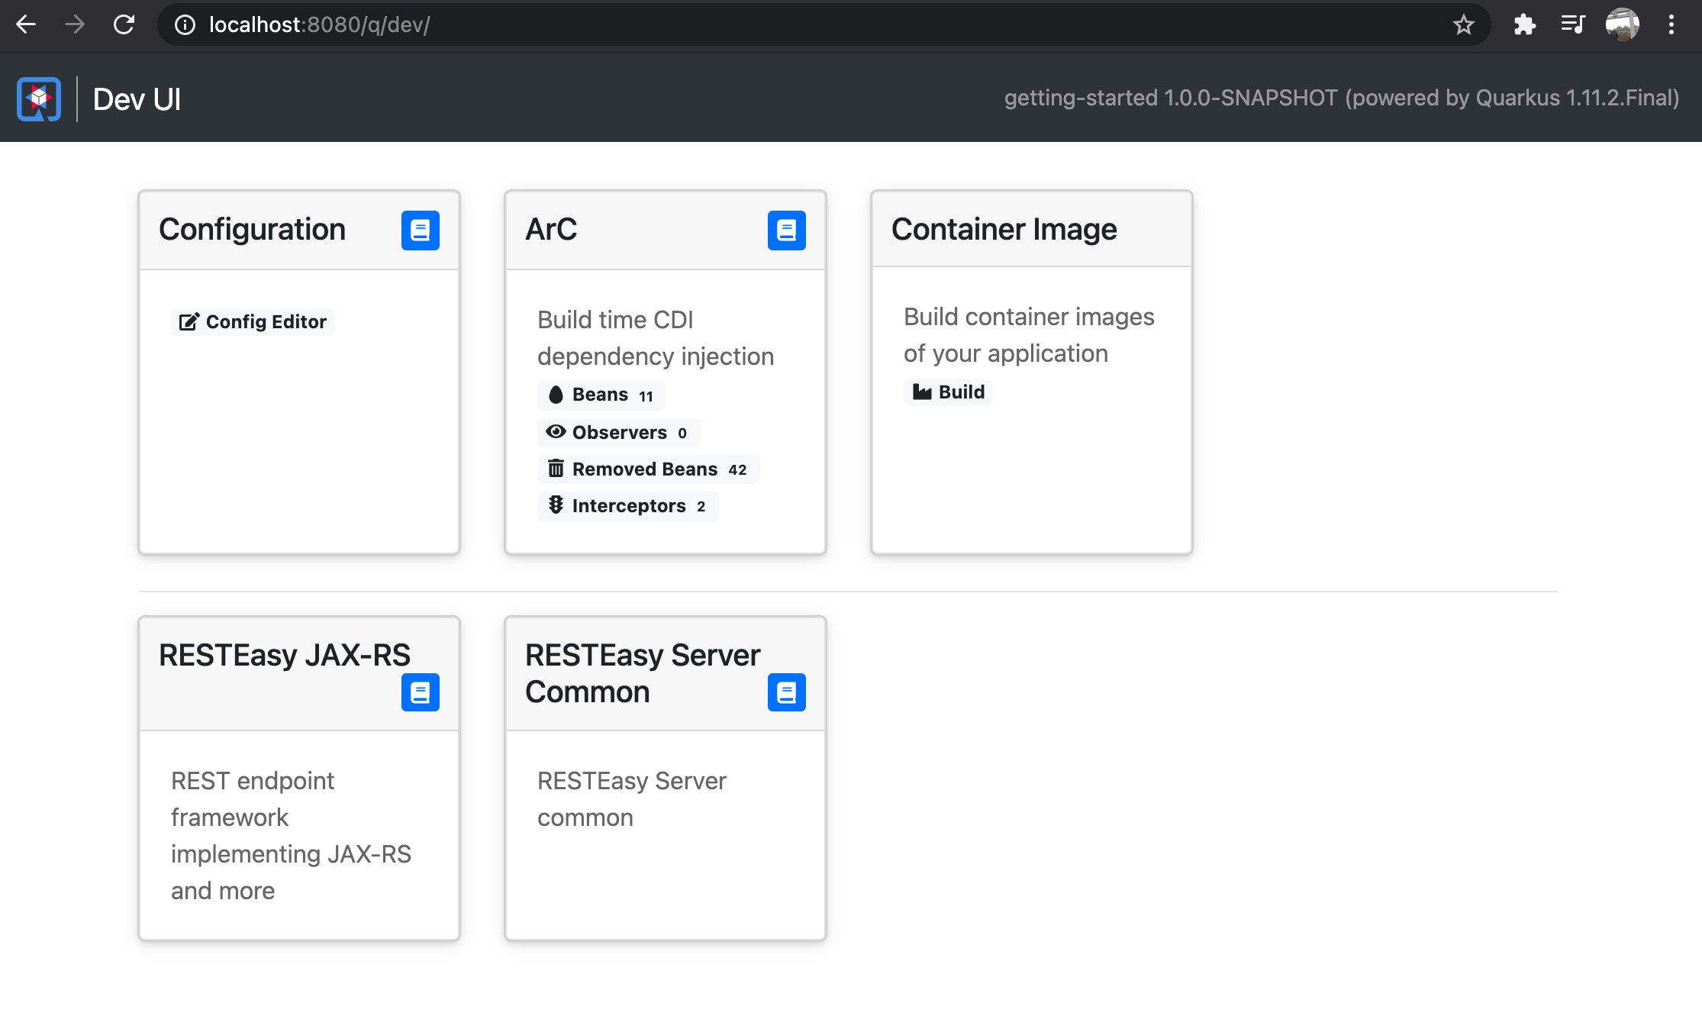
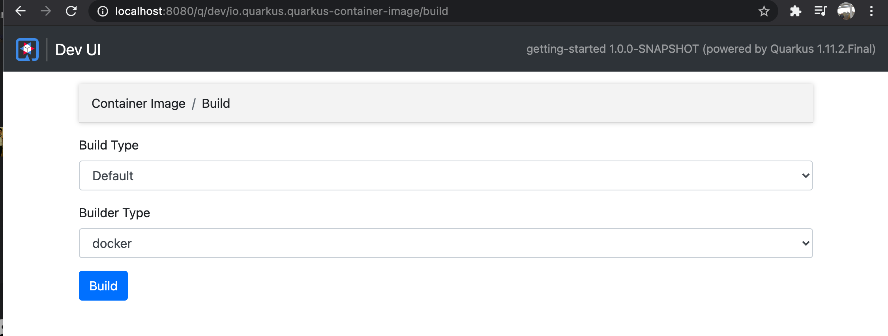
Quarkus Dev UI

Slide 17
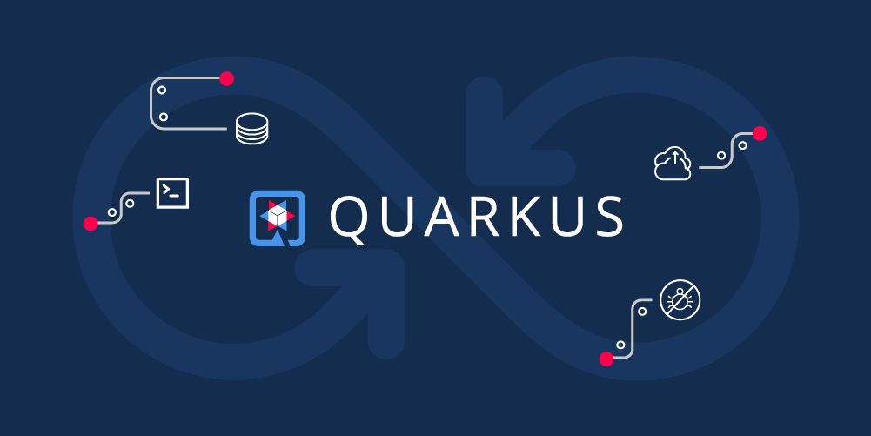
https://github.com/danieloh30/quarkus-remote
Quarkus Live Code Reload on OpenShift

Slide 18
Why Quarkus?

Slide 19



An Open Source
stack to write Java apps
Cloud Native
Microservices
Serverless
Notes:
Historical Java stack consisted of an application server running multiple applications. Red Hat has customers running over 100 applications on one JBoss EAP instance. Over most of the last 15-20 years, the Java application stack has been optimized to run large heaps and highly dynamic frameworks that make decisions at runtime.

Slide 20
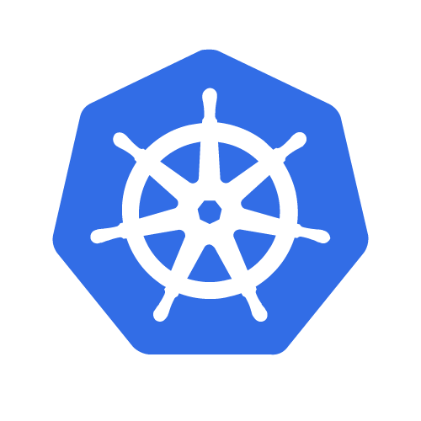

Quarkus - Optimizing the Stack
QUARKUS WORKSHOP
Architecture: Microservices, Serverless Deployment: Single App App Lifecycle: Minutes/Days
Memory: 10 MBs + RAM
Startup Time: Milliseconds
App (Imperative / Reactive)
Optimized Application Frameworks
Java Virtual Machine (Hotspot)
Optional
Notes:
The main difference between the Traditional cloud native stack and Quarkus is that Quarkus is optimized for running in containers moving a lot of the dynamic behaviour from runtime to build time.
This provides a stack that is largely familiar for a Java developer, but starts in milliseconds and highly optimized memory usage.

Slide 21
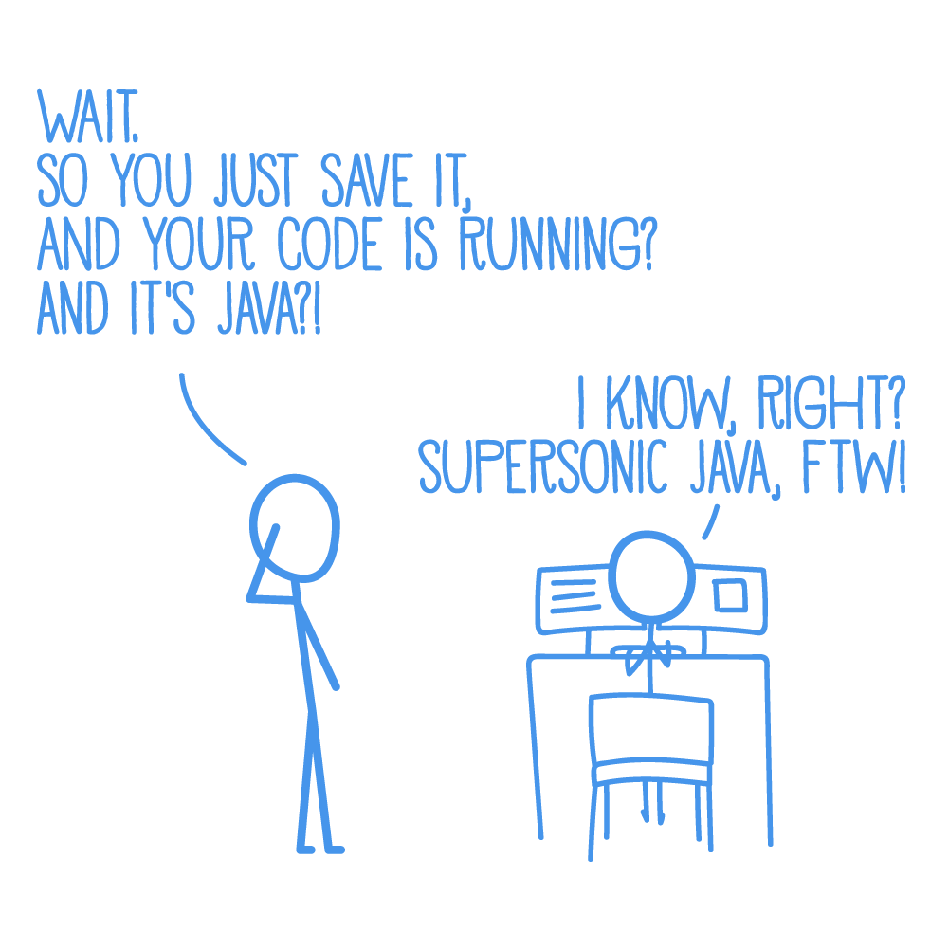
QUARKUS WORKSHOP
Quarkus brings real Developer Joy
A cohesive platform for optimized developer joy:
Based on standards, but not limited
Unified configuration
Reactive & Imperative, all in one
Zero config, live reload in the blink of an eye
Streamlined code for the 80% common usages, flexible for the 20%
No hassle native executable generation
Notes:
Historical Java stack consisted of an application server running multiple applications. Red Hat has customers running over 100 applications on one JBoss EAP instance. Over most of the last 15-20 years, the Java application stack has been optimized to run large heaps and highly dynamic frameworks that make decisions at runtime.

Slide 22
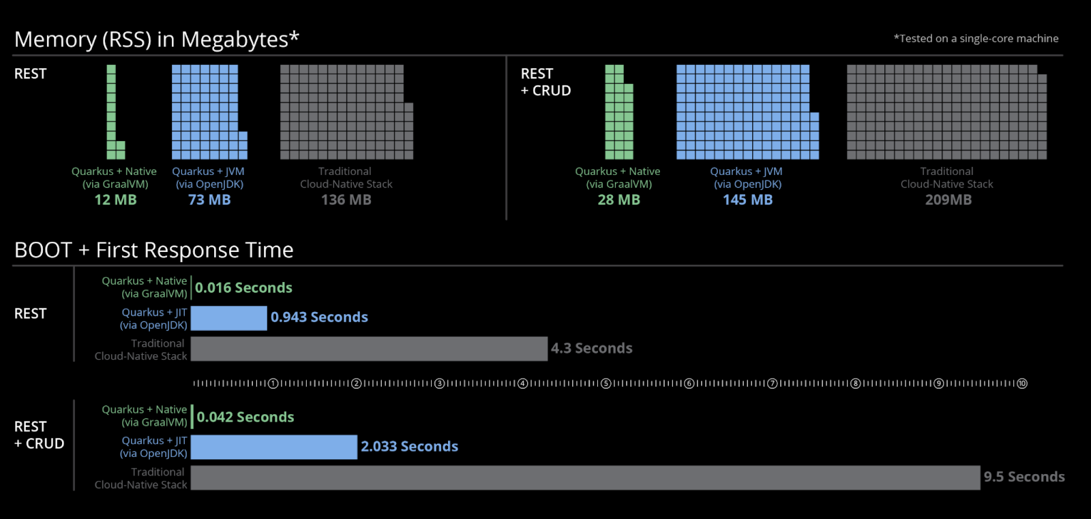
Container Native
Quarkus Fundamentals
Fast Startup and Low Memory Utilization

Slide 23
Cloud Native Java Stack + Containers
Node
Node
Node
Node
Node
EAP, WAS Liberty or Spring Boot
Quarkus on JVM
NodeJS
Quarkus Native
Quarkus Native
Quarkus Native
Go
Go
Go
Quarkus on JVM
NodeJS
Quarkus Native
Quarkus Native
Quarkus Native
Go
Go
Go
EAP, WAS Liberty or Spring Boot
Quarkus on JVM
NodeJS
Quarkus Native
Quarkus Native
Quarkus Native
Go
Go
Go
Quarkus on JVM
NodeJS
Quarkus Native
Quarkus Native
Quarkus Native
Go
Go
Go
EAP, WAS Liberty or Spring Boot
Quarkus on JVM
NodeJS
Quarkus Native
Quarkus Native
Quarkus Native
Go
Go
Go
EAP, WAS Liberty or Spring Boot
Quarkus on JVM
NodeJS
Quarkus Native
Quarkus Native
Quarkus Native
Go
Go
Go
Quarkus on JVM
NodeJS
Quarkus Native
Quarkus Native
Quarkus Native
Go
Go
Go
CONTAINER ORCHESTRATION
“We could run 3 times denser deployments without sacrificing availability and response times of services”
https://developers.redhat.com/blog/2017/03/14/java-inside-docker/
Notes:
New state of Java apps w/ Quarkus
But, memory is cheap. Do I really need another application stack?
Saving a couple of 100MB of memory and starting faster might be seen as unimportant if we consider this for a single application (a monolith). I’ve talked to several customers that where considering moving away from Java before we presented Quarkus to them. Not because they don’t like Java, but simply because when using it in on a container orchestration platform memory quickly becomes a bottleneck. The same customers have told me that they see 90% memory usage with less than 30 % CPU utilization when using Spring Boot in OpenShift. This picture illustrates the problem. If we had three different nodes in a OpenShift cluster and pinned a Spring Boot application to a single node, then did them same for a similar applications written in NodeJS and Go we can see that the number of instances that we can run are wastely lower compared to NodeJS.

Slide 24
QUARKUS WORKSHOP
Quarkus Unifies Imperative and Reactive
@Inject
SayService say;
@GET
@Produces(MediaType.TEXT_PLAIN)
public String hello() {
return say.hello();
}
@Inject @Stream(”kafka”)
Publisher<String> reactiveSay;
@GET
@Produces(MediaType.SERVER_SENT_EVENTS)
public Publisher<String> stream() {
return reactiveSay;
}
Combines both Reactive and imperative development in the same application
Reactive Messaging - Apache Kafka, MQTT, AMQP…
Reactive Services
Notes:
Historical Java stack consisted of an application server running multiple applications. Red Hat has customers running over 100 applications on one JBoss EAP instance. Over most of the last 15-20 years, the Java application stack has been optimized to run large heaps and highly dynamic frameworks that make decisions at runtime.

Slide 25
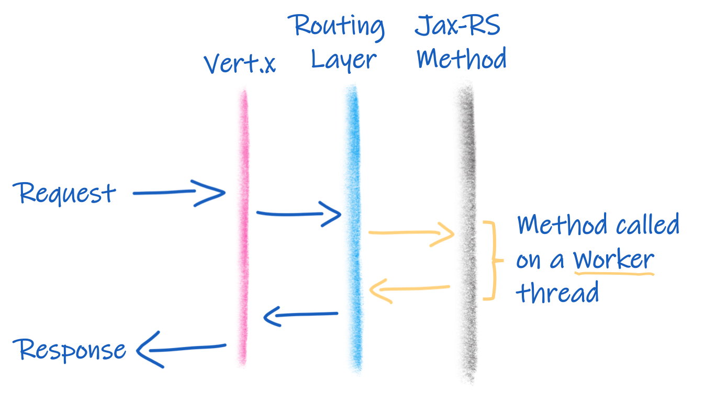
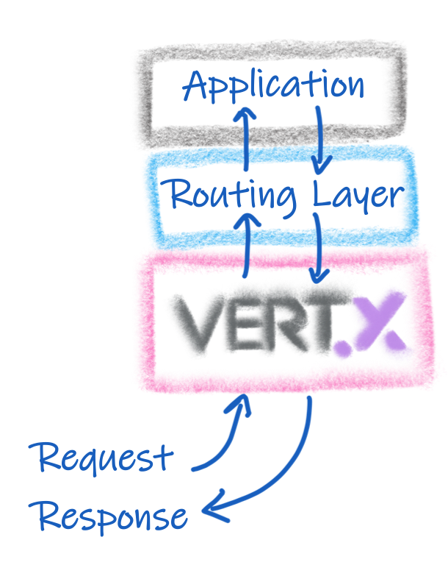
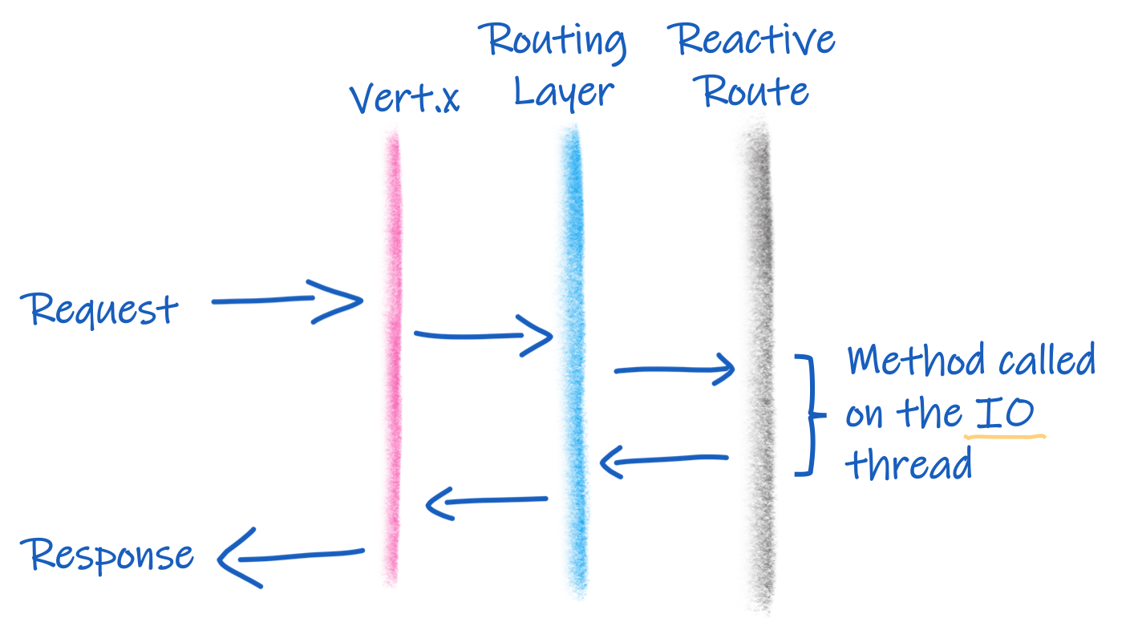
Quarkus is Reactive!

Slide 26
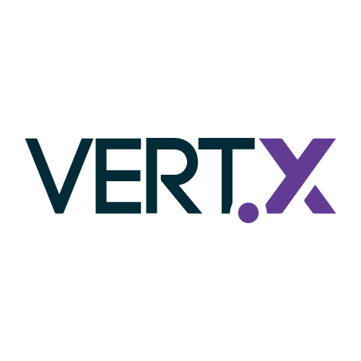

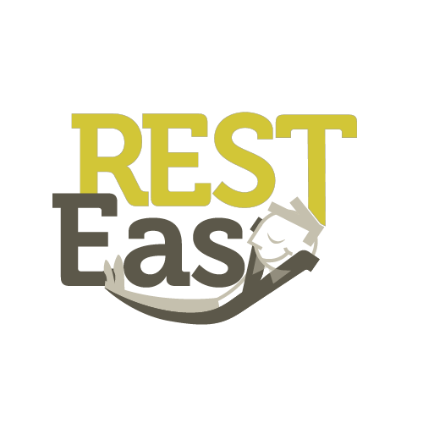






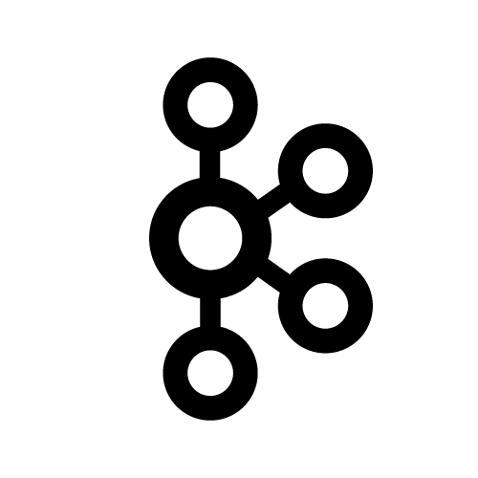

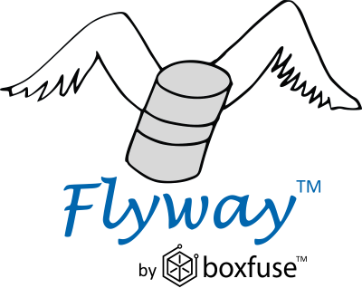





Quarkus uses Best of Breed Frameworks & Standards
Eclipse Vert.x
Hibernate
RESTEasy
Apache Camel
Eclipse MicroProfile
Netty
Kubernetes
OpenShift
Jaeger
Prometheus
Apache Kafka
Infinispan
Flyway
Neo4j
MongoDB
MQTT
KeyCloak
Apache Tika

Slide 27



Quarkus Tools - Build
mvn io.quarkus:quarkus-maven-plugin:1.3.2.Final-redhat-00001:create \
-DprojectGroupId=org.acme \
-DprojectArtifactId=getting-started \
-DplatformGroupId=com.redhat.quarkus \
-DplatformVersion=1.3.2.Final-redhat-00001 \
-DclassName="org.acme.quickstart.GreetingResource" \
-Dpath="/hello"
cd getting-started
Notes:
Developer Tools
The easiest way to scaffold a Maven project, is currently to use the Quarkus Maven plugin:
mvn io.quarkus:quarkus-maven-plugin:1.3.2.Final-redhat-00001:create \
-DprojectGroupId=org.acme \
-DprojectArtifactId=getting-started \
-DplatformGroupId=com.redhat.quarkus \
-DplatformVersion=1.3.2.Final-redhat-00001 \
-DclassName="org.acme.quickstart.GreetingResource" \
-Dpath="/hello"
cd getting-started

Slide 28


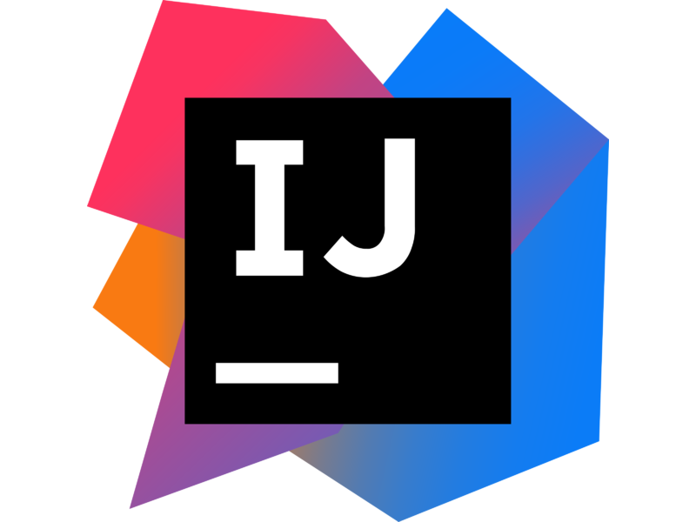

Quarkus Tools - IDE
VSCode
Eclipse
IntelliJ
che.openshift.io
Notes:
Developer Tools
Tooling done by Quarkus community and Red Hat Developer team
Language Server Based

Slide 29




Quarkus Included in Kubernetes & Red Hat OpenShift
Single Step Deployment
Platform Integration
IDE Integration
Support Lifecycle
Includes OpenShift developer extensions
Simplified deployment of JVM and Native mode applications
Includes support for ConfigMap/Secrets volume mounts
No-code health probes
Config via ConfigMap
OpenMetrics / OpenTracing support
Knative serving / eventing* / functions**
Remote dev/debug with Live Coding
OpenShift Dev Console**
CodeReady Workspaces plugin
Scaffold new projects
Code completion
Live Coding
Quarkus-specific API suggestions & snippets
Identical support scope vs. Runtimes
Support for 3.11, latest 4.x
Fully supported during OpenShift EUS lifecycle
OCP, OSD, ARO, etc
* Dev Preview
** Coming Soon

Slide 30
I’m a Spring developer. Why Quarkus?

Slide 31
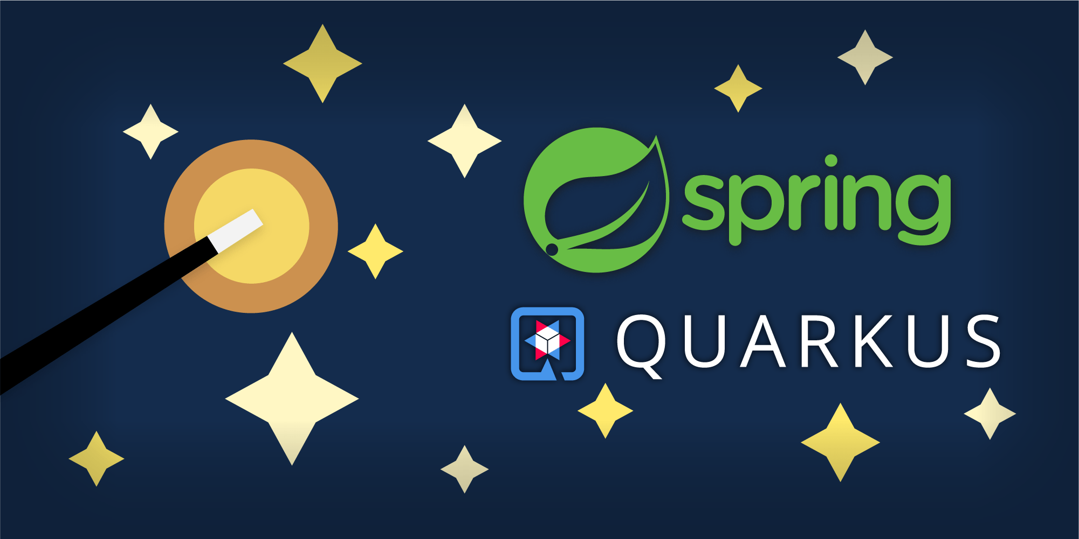
https://developers.redhat.com/blog/2021/02/09/spring-boot-on-quarkus-magic-or-madness/
https://github.com/edeandrea/todo-spring-quarkus.git
Spring Boot on Quarkus: Magic or madness?

Slide 32
DEMO Time!

Slide 33




“We became increasingly worried about resource consumption that Spring Boot was having while being deployed on the Kubernetes cluster… It became increasingly cumbersome to find ways to circumvent the methodology we were using just to squeeze every little bit of performance out of Spring Boot”
Christos Sotiriou
DXL Backend Chapter Lead, Vodafone Greece
Notes:
https://www.youtube.com/watch?v=RYGvDtMM95I&list=PLsM3ZE5tGAVatO65JIxgskQh-OKoqM4F2&index=4
Christos So-ted-ee-oh
, one of the lead engineers on the product, said In early 2019 the team was getting more and more concerned with performance as they grew.
Much like Java itself, incremental improvements they made in their application infrastructure were not having the desired effect.
Vodafone greece evaluated several different alternatives like Node.js, Golang, and Vert.x. Vert.x was most promising, and in fact underpins Quarkus in many ways, so when they found Quarkus in februrary it was a no-brainer.

Slide 34
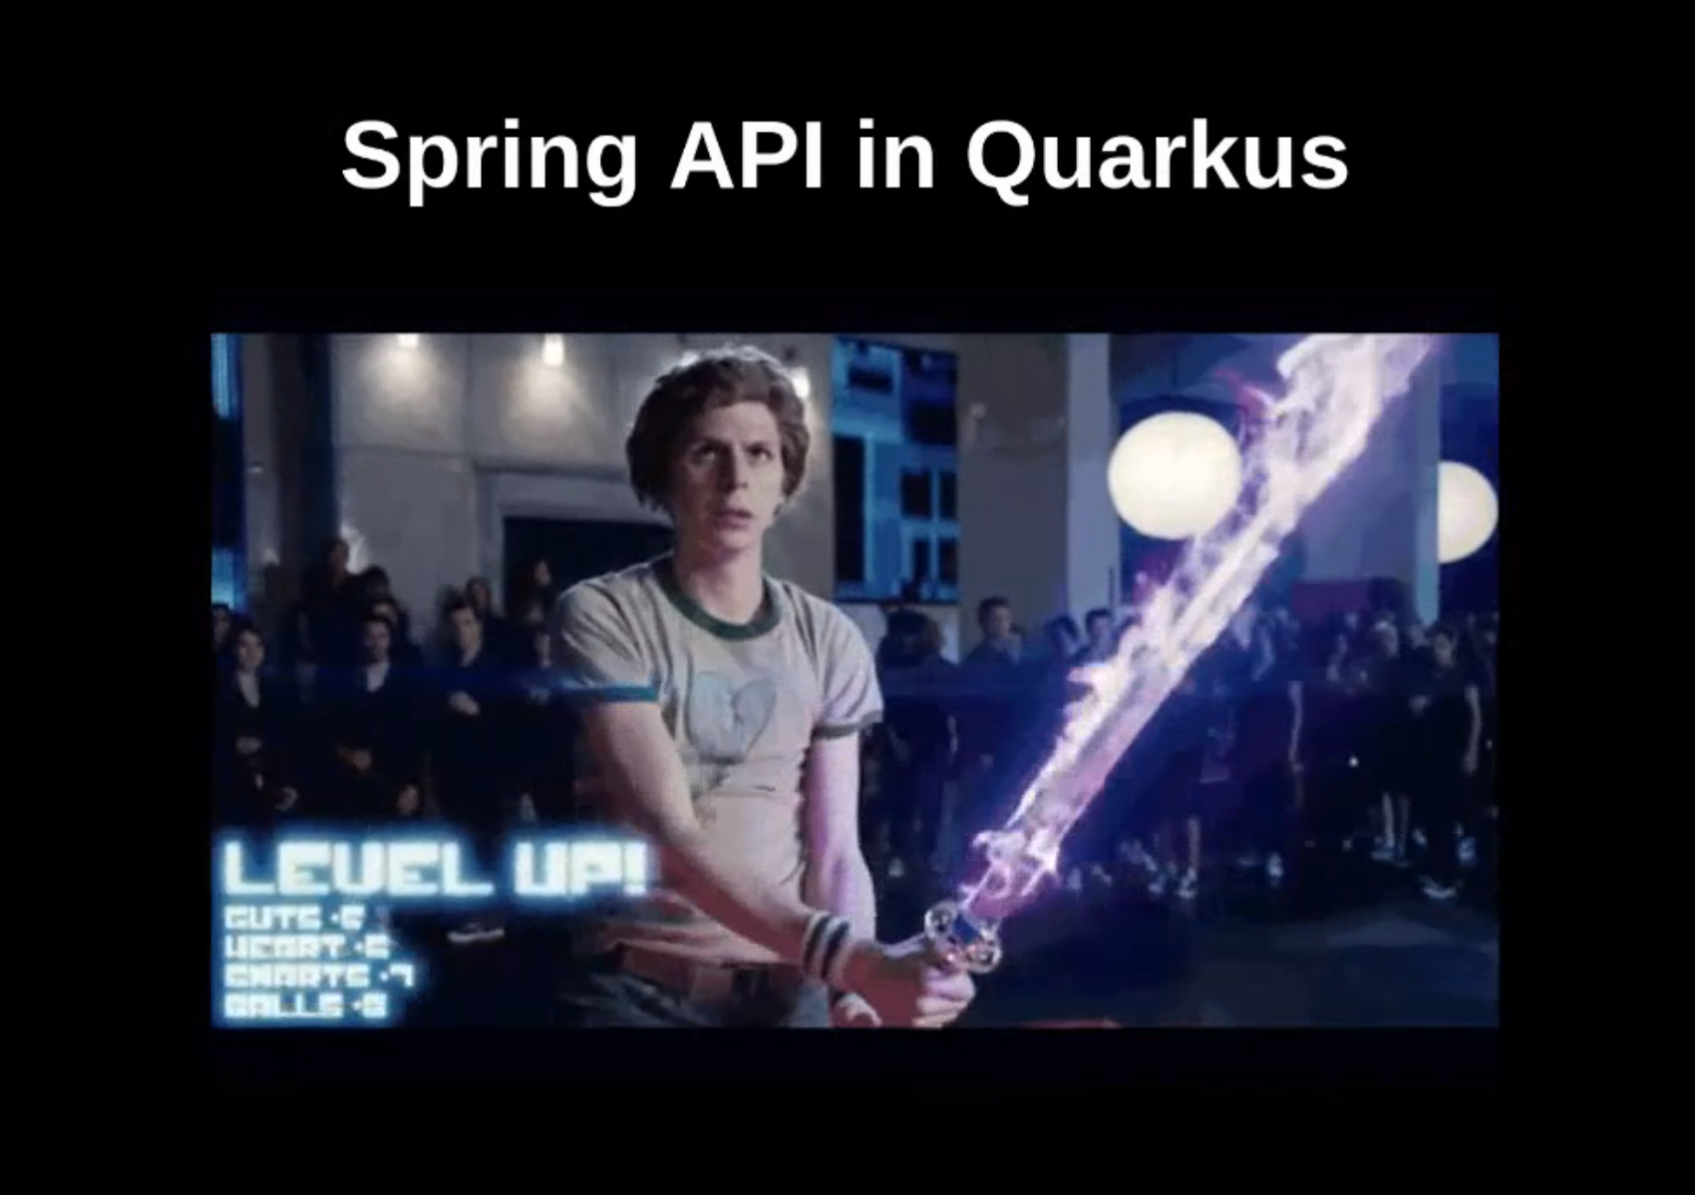
Spring in Quarkus!

Slide 35
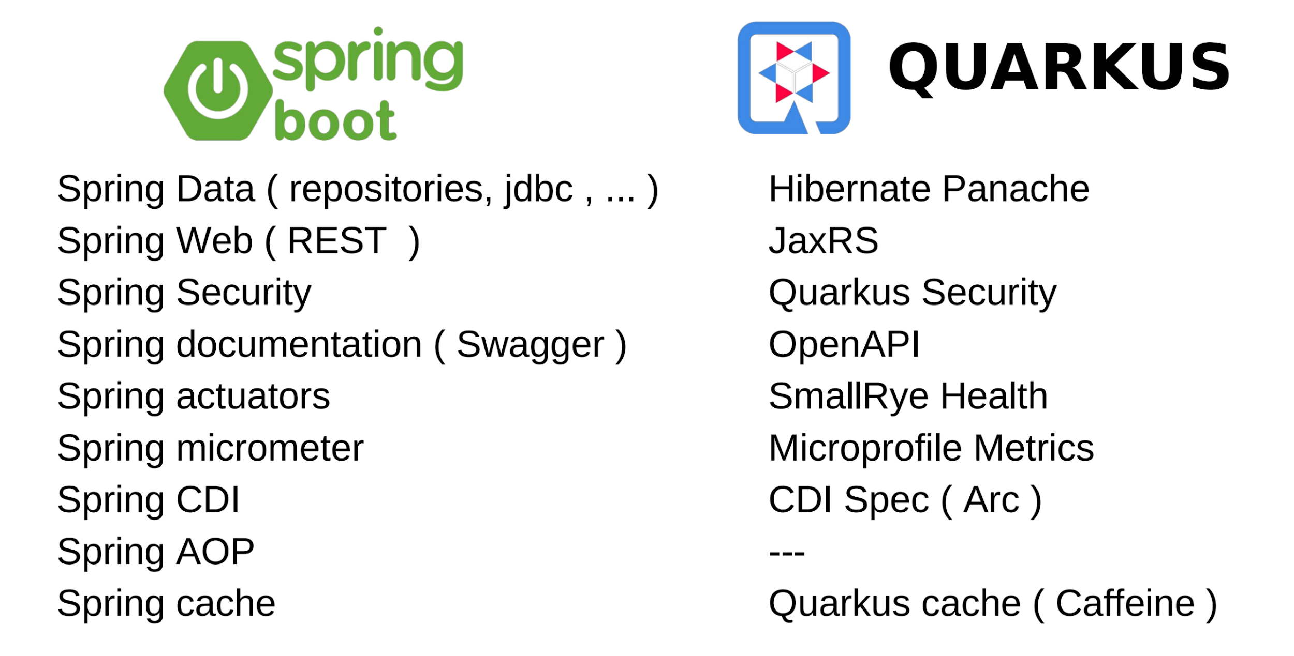
Notes:
https://quarkus.io/guides/cdi#ok-injection-looks-cool-what-other-services-are-provided
No spring aop, but have
Lifecycle Callbacks
Interceptors
Events and Observers

Slide 36
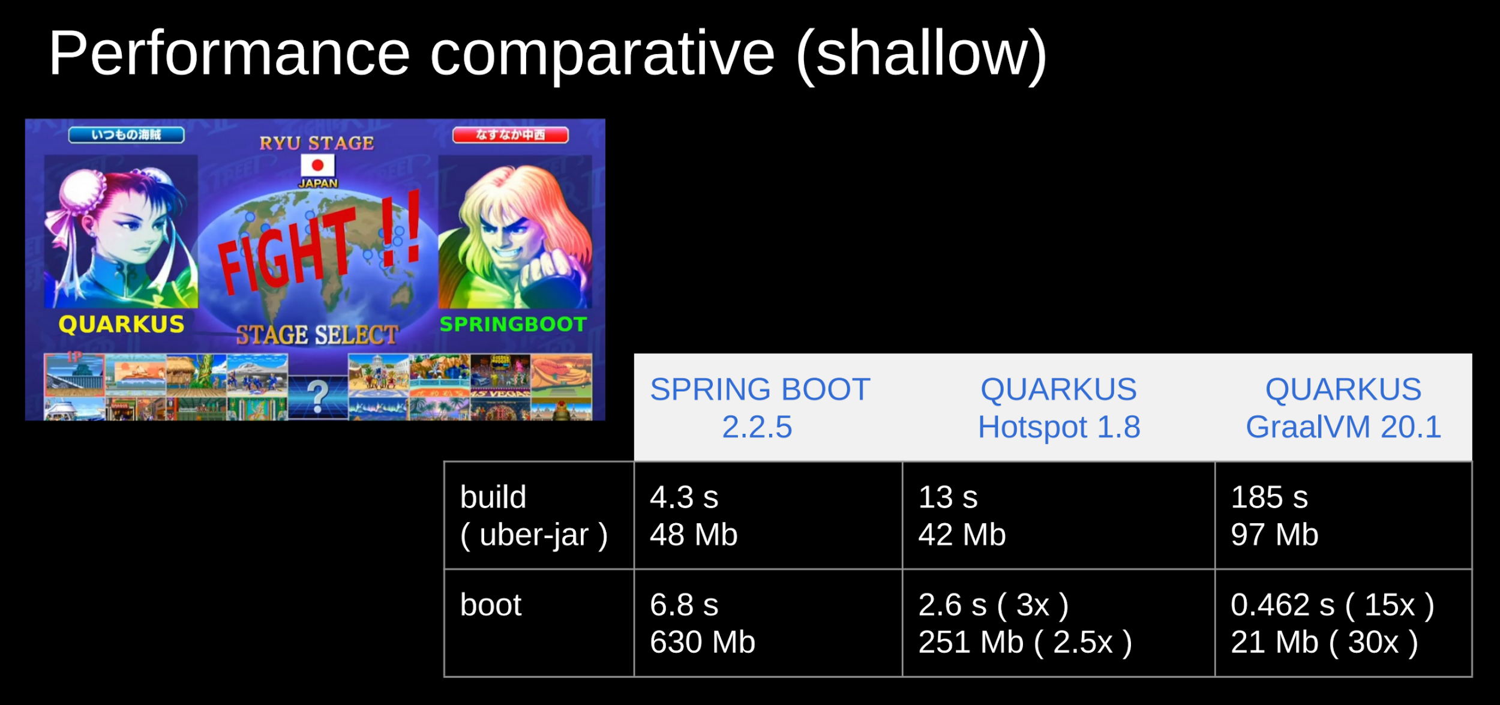

Slide 37
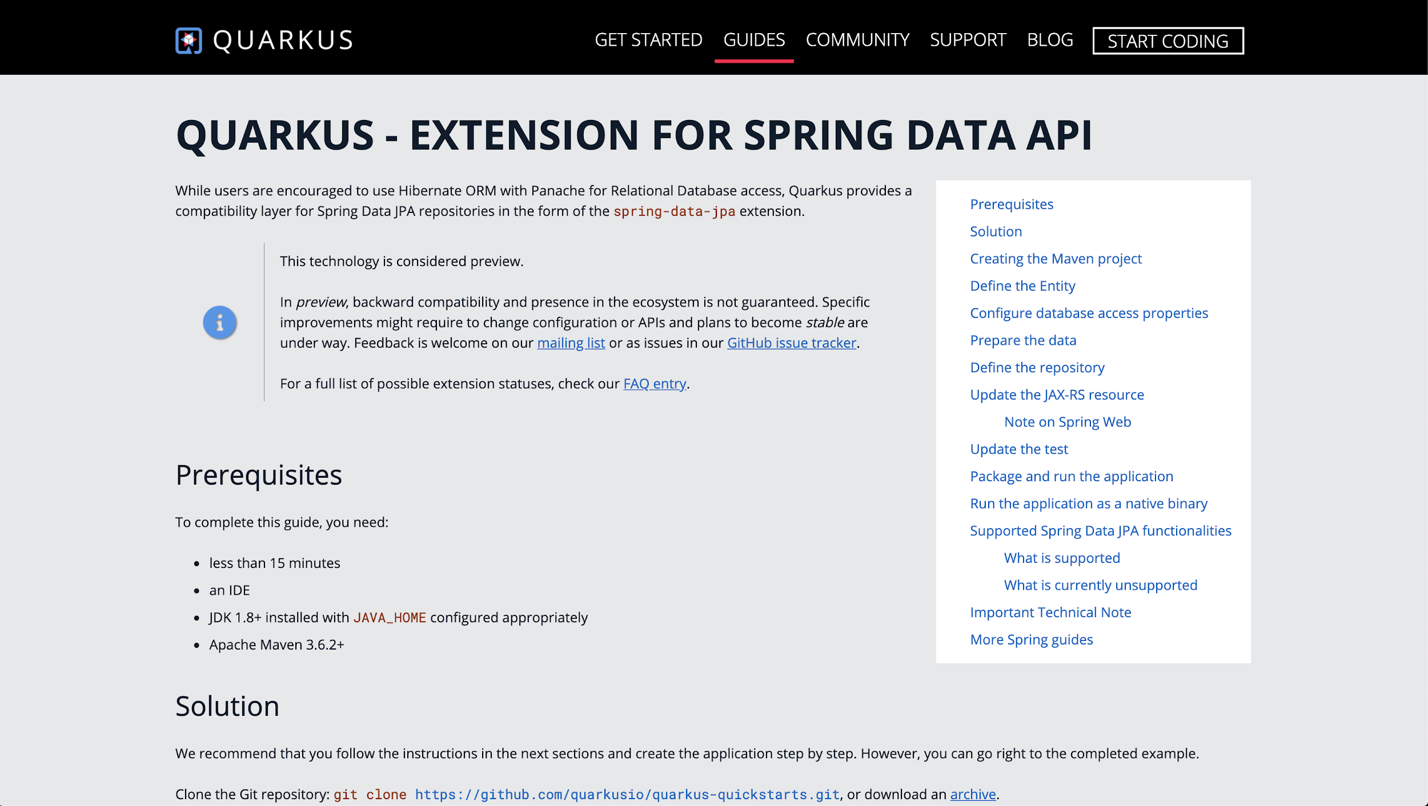
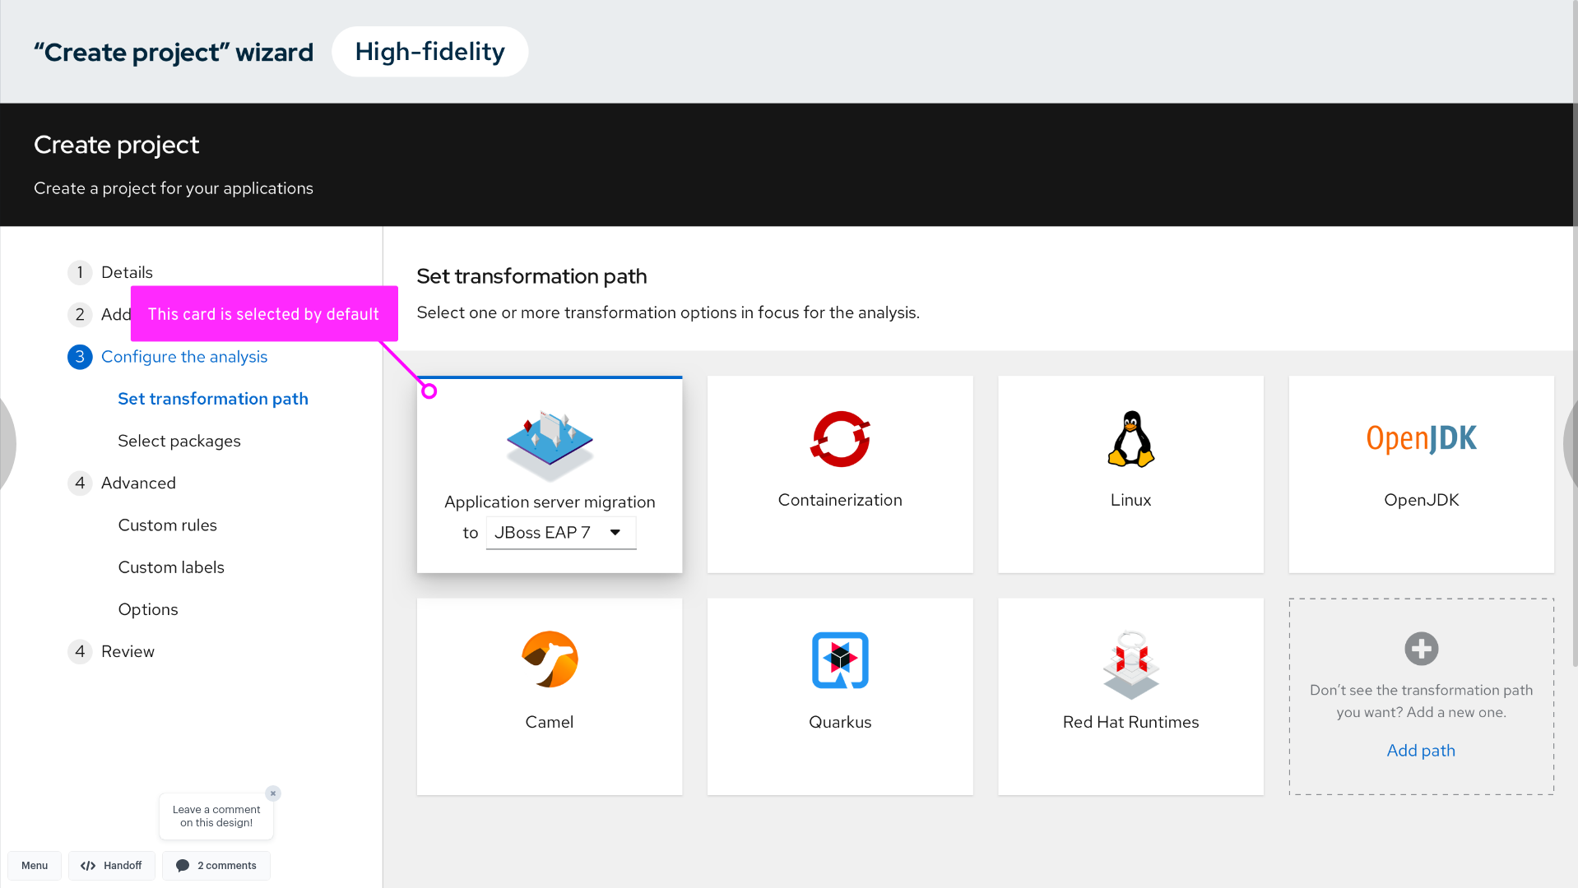
Spring to Quarkus Migration
SPRING API COMPATIBILITY IN QUARKUS
MIGRATION TOOLKIT FOR APPLICATIONS
→ A subset of Spring Framework / Spring Boot APIs in Quarkus to minimize learning curve
→ Java code analysis, effort estimation, risk identification, migration execution via Web UI, CLI, IDE Plugins.
→ New rules and UI in MTA 5.1
Notes:
Reading docs is fine, but tooling that can get you 80% of the way there is even better

Slide 38
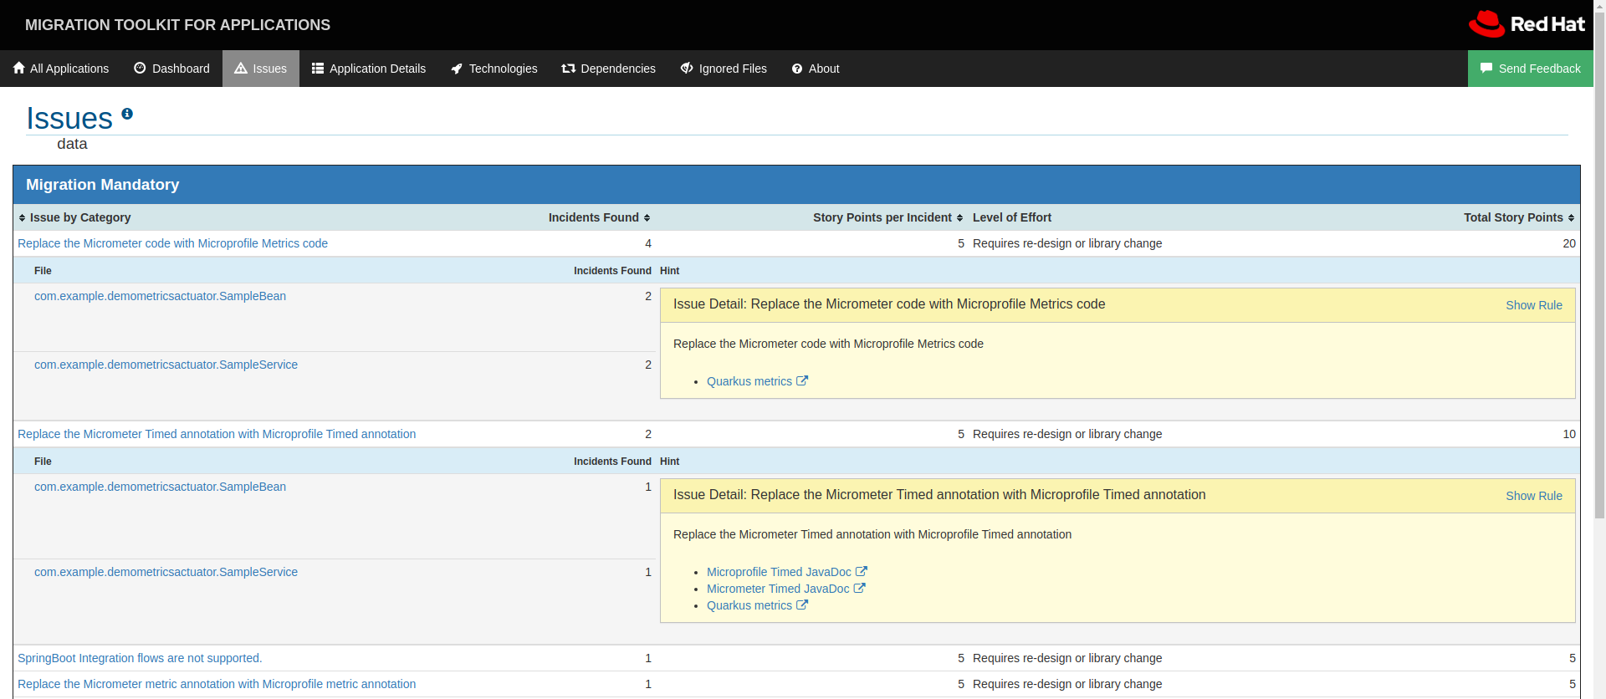
MTA 5.1 Rules
MIGRATION TOOLKIT FOR APPLICATIONS
Spring Boot to Quarkus

Slide 39




Summary
With Quarkus
Container First
Tailors your app for HotSpot & GraalVM
Fast boot time and low RSS memory
Serverless fit
Developer Joy
Live coding
Unified configuration
Unifies Imperative & Reactive
Combines blocking and non-blocking
Built-in event bus
Best of Breed Libraries & Standards
90+ extensions
“Powered by Quarkus” applications
Notes:
Why should developers care?
Container First
Quarkus is a Kubernetes-native Java framework targeted for containers and serverless due to it’s fast startup, low memory, and small application size.
Developer Joy
Quarkus works out of the box with popular Java standards, frameworks, and libraries. Developers familiar with these will feel at home with Quarkus, which streamlines code for 80% of common use cases, while providing the flexibility to cover the remaining 20%. Quarkus also provides live coding for fast iteration during development, where code changes are automatically and immediately reflected in the running app.
Unifies Imperative and Reactive Programming Models
Developers can choose the right programming model that best fits their use case, and easily integrate their code with other components in a reactive system like reactive streams with Vert.x and Kafka, reactive database APIs, and much more.
Best of Breed Standards & Libraries
The Quarkus community has developed over 90 extensions which provide additional enhancements and integrations to the framework including the ability to compile an application into a native executable.

Slide 40
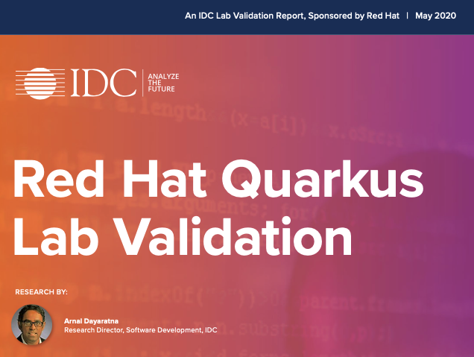
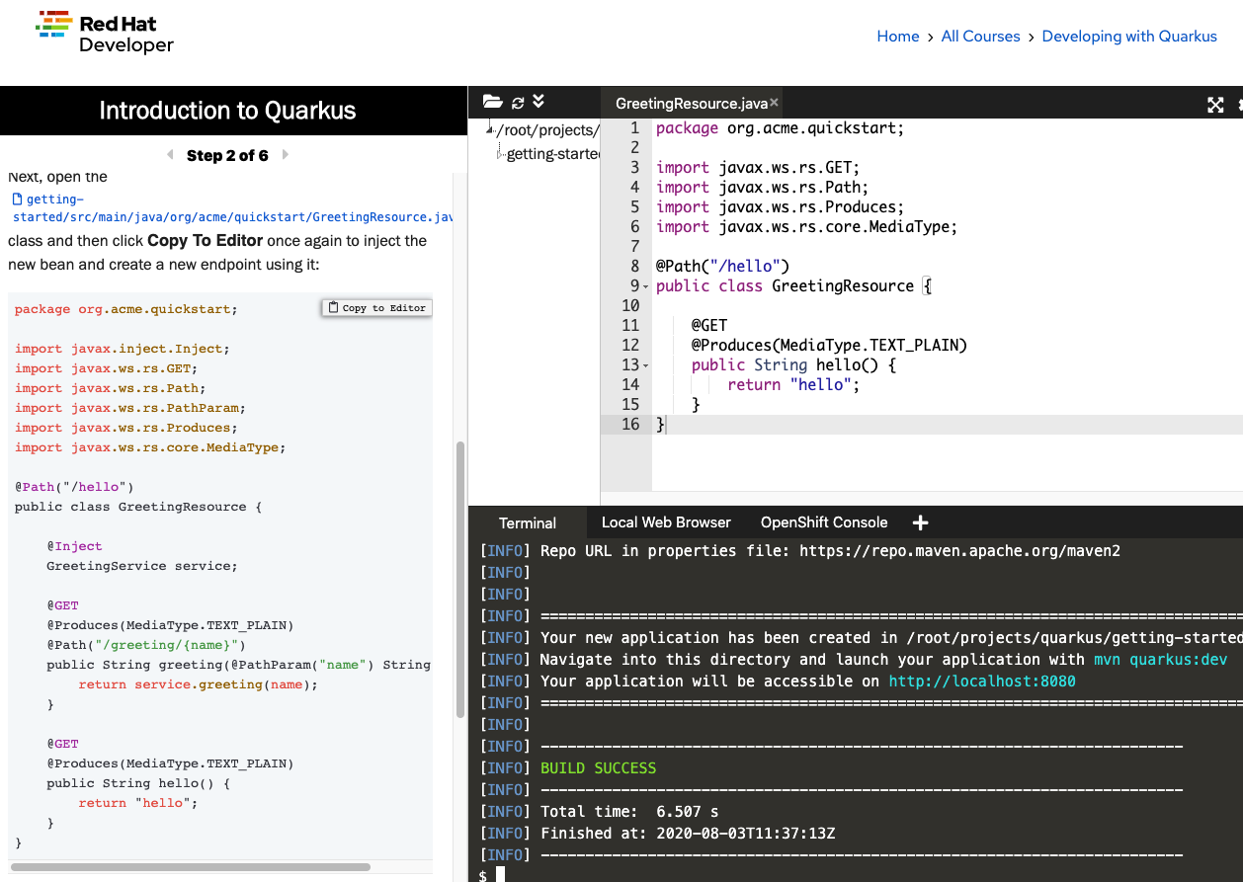
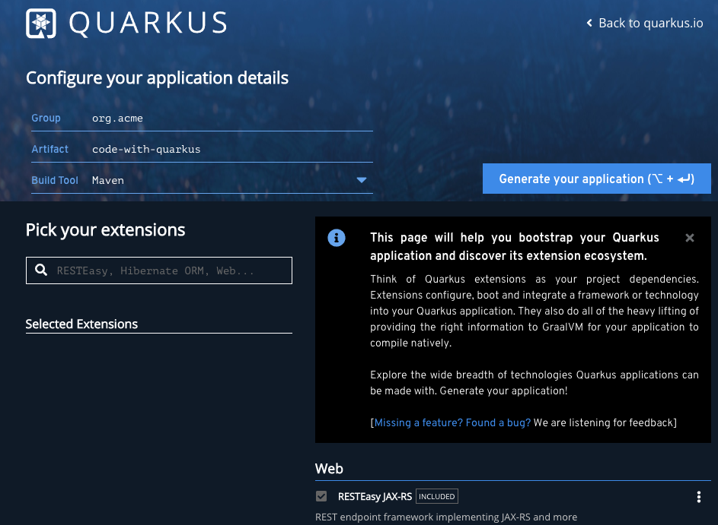

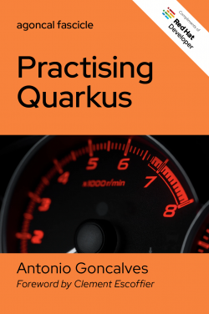

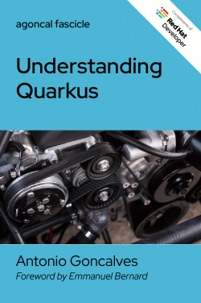

Getting Started
QUARKUS WORKSHOP
https://qrgo.page.link/3q7hr
red.ht/try-quarkus
code.quarkus.io
Assets on Quarkus
Notes:
Before you go here are a few resources to get you started. To see how quarkus compares to traditional Java for both developers and operators, check out the IDC study done a few months ago. If you want to get hands-on quickly, you can try out Quarkus directly in your browser, and if you want to dig in and build your own apps, code.quarkus.io is there for you.

Slide 41
Thank you
Red Hat is the world’s leading provider of enterprise open source software solutions. Award-winning support, training, and consulting services make
Red Hat a trusted adviser to the Fortune 500.

